Slide 1
Week 8 Recitation
Number System & Data (Continued)
Rifat Bin Rashid
Teaching Assistant
Dept. of ECE, Rutgers University

Slide 2
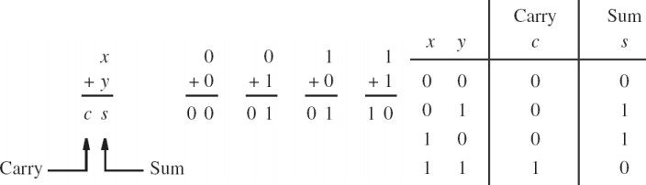
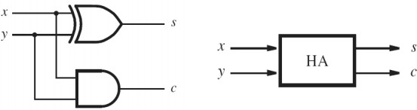
Half Adder

Slide 3
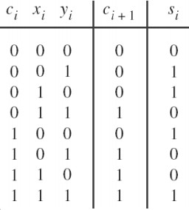
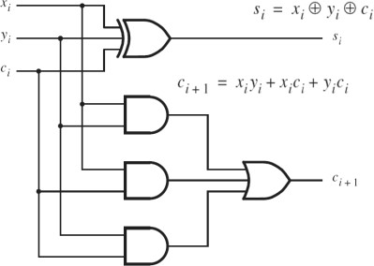
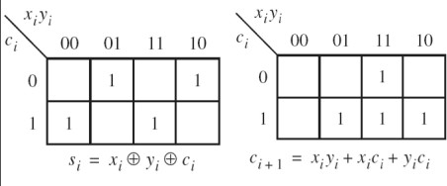
Full Adder

Slide 4
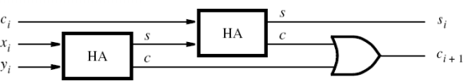
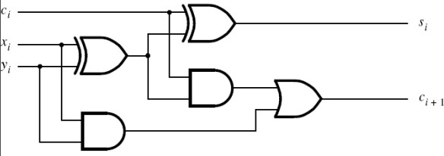
Full Adder from Half Adder

Slide 5
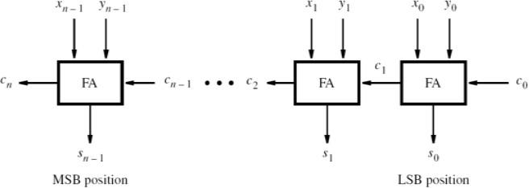
Ripple Carry Adder

Slide 6
Unicode and UTF-8
Unicode (the code points)
A universal numbering system for characters (letters, digits, symbols, emoji). Each character has a unique code point
written like U+0041, U+1F60A, etc.
Range: Lowest = U+0000. Highest = U+10FFFF.
Bits needed: Up to 21 bits (0x10FFFF = 1,114,111₁₀ = 1 0000 1111 1111 1111 1111₂ ).
Planes: 17 planes × 65,536 code points each

Slide 7
Unicode and UTF-8
UTF-8 (Unicode Transformation Format – how we store Unicode as bytes)
A variable-length encoding of Unicode code points into 1–4 bytes.
Popular: Backward-compatible with ASCII; English text stays compact (1 byte per ASCII char).
Byte patterns:
Data bits carried: 7, 11, 16, or 21 bits respectively. (The extra prefix bits mark length, not character data.)
Summary : Unicode defines the character numbers (0 to U+10FFFF, needs ≤21 bits). UTF-8 stores those numbers in 1–4 bytes, using short forms for ASCII and longer forms for higher code points like emoji.
Range (hex) | Bytes | Pattern
U+0000–U+007F | 1 | 0xxxxxxx
U+0080–U+07FF | 2 | 110yyyyy 10xxxxxx
U+0800–U+FFFF | 3 | 1110zzzz 10yyyyyy 10xxxxxx
U+10000–U+10FFFF | 4 | 11110uuu 10uuzzzz 10yyyyyy 10xxxxxx

Slide 8
Character → UTF-8
Step 1 : Character to Unicode code point in HEX & then binary
大 = U+5927 = hexadecimal 5927 = 0101 1001 0010 0111
Step 2. Choose the correct UTF-8 pattern
U+5927 = 0x5927 lies between U+0800 and U+FFFF 3-byte pattern: 1110zzzz 10yyyyyy 10xxxxxx
Step 3. Fill in the bits
Our 16 bits of data: 0101 1001 0010 0111
Break them (from left to right) into z y x groups:
zzzz yyyyyy xxxxxx == 0101 | 100100 | 100111
Insert them into the 3-byte template:
大 → U+5927 → UTF-8 = E5 A4 A7
Byte | Pattern | Fill in bits | Result
1 | 1110zzzz | 1110 0101 | E5
2 | 10yyyyyy | 10 100100 | A4
3 | 10xxxxxx | 10 100111 | A7

Slide 9
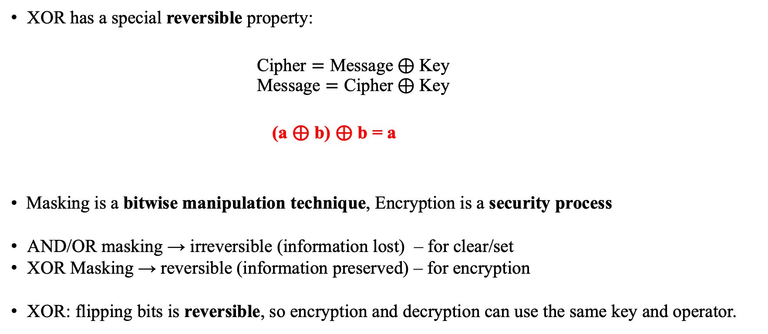
Masking
XOR has a special reversible property:
$$\text{Cipher}=\text{Message}⊕\text{Key}$$
$$\text{Message}=\text{Cipher}⊕\text{Key}$$
(a ⊕ b) ⊕ b = a
Masking is a bitwise manipulation technique, Encryption is a security process
AND/OR masking → irreversible (information lost) – for clear/set
XOR Masking → reversible (information preserved) – for encryption
XOR: flipping bits is reversible, so encryption and decryption can use the same key and operator.

Slide 10
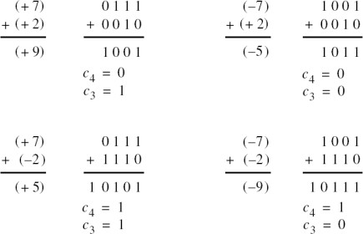
Overflow
OF = C_in_{n} ^ C_in_{n-1}

Slide 11
Overflow
OF
OF
OF
OF

Slide 12
Number System
1. Convert the following hex to binary
2. Convert the following binary to hex
C | 2 | 4 | B | 5 | A | 7 | E
1101 | 1001 | 0111 | 1010 | 0110 | 1111 | 0001 | 0011

Slide 13
Number System
Convert the following unsigned 8-bit binary to decimal 10101100 =
Convert the following decimal to binary 197 =
Compute 16’H9DC6 & 16’HA4DC = binary __________________________ hex _________
Compute 32’H9CDAC482 ^ 32’HD01CBF23 ^ 32’HD01CBF23 = ___________________
reg [7:0] hamlet = 8’h2B | ~8’h2B; // hamlet = __________
reg[15:0] exec = 16’h9B9B ^ 16’hC4C4; // exec = ________
Identify the ASCII message: 70 61 72 72 6f 74 ______________________
The encrypted message is: 01 02 00 00 01 The key is c. Original message ___________

Slide 14
Number System
State the smallest and largest values that can be stored in each variable (½ pt each)
reg signed [7:0] x; // min __________ max __________
reg signed [15:0] y; // min __________ max __________
reg [9:0] z; // min __________ max __________

Slide 15
2’s Complement
Compute the 2s complement of this number, state what that value is in decimal, then the value of the original number 10111100 2s complement= _____________ decimal=___________ original=__________
First state the value of the number, then compute the 2s complement and state the decimal value of that number 01110011 = _________ 2s complement = ____________ decimal=_______

Slide 16

https://github.com/RifatBinRashid/ECE_231_DLD_RU

